Slide 1
Where should we build new homes?
Lesson 8
Decision-making exercise.

Slide 2
Definitions…
Look at the different terms below.
Match the correct definition from the list on the right, to the terms on the left.
Word |  | Definition
Brownfield site |  | An area surrounding an urban area on which building is restricted.
Greenfield site |  | A conservation designation that gives protection to an area, usually for unique habitats, flora or fauna.
Site of Special Scientific Interest |  | Land that hasn’t been built upon, usually in the Rural-Urban fringe.
Area of Outstanding Natural Beauty |  | Land usually within the CBD or Inner City that has been build on before
Green belt land |  | A landscape that is protected to conserve its significant landscape value and are considered the most special landscapes in the country.

Slide 3
Thinking about what you know…
Place each type of site along this continuum.
Brownfield site | Greenfield site | Site of Special Scientific Interest | Area of Outstanding Natural Beauty | Green belt land
Never build on ever
Fine to build on

Slide 4
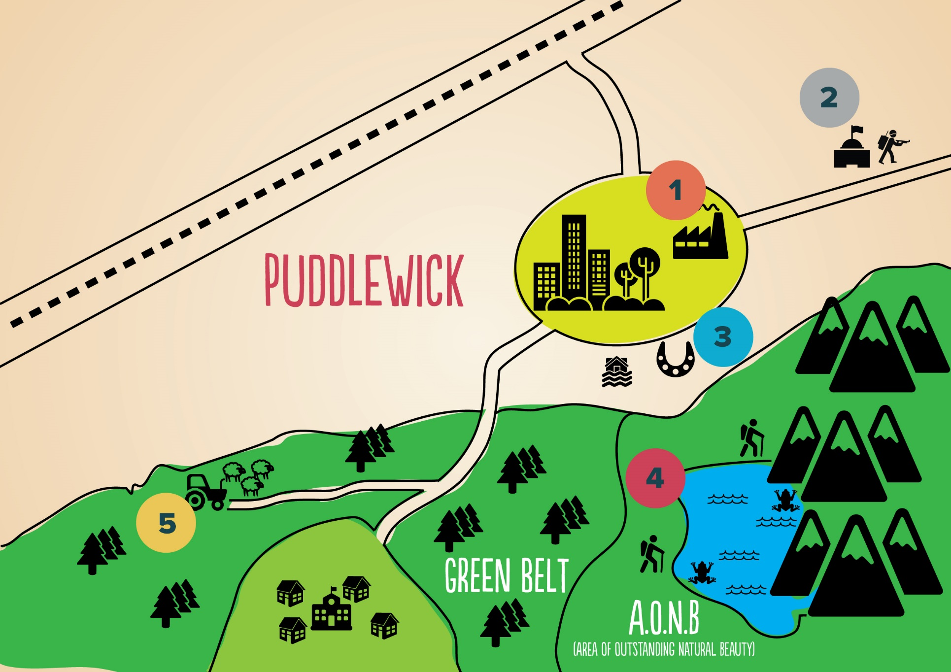

Slide 5
Task…
Look at the information available for the five site options.
For each, fill out the relevant part of the table below.
Site | Advantages | Disadvantages | Rank order (1 = best to build on; 5 = never build on)
Brownfield land within Puddlewick
Brownfield land outside Puddlewick
Greenfield land
Land within an Area of Outstanding Natural Beauty
Land on the green belt

Slide 6
Option 1: Brownfield land within puddlewick
“
The site is brownfield land on a former industrial laundrette in the town. It has good access and the surrounding infrastructure can cope with additional homes. Remedial work would need to take place to remove contaminants from soil on the land as a result of its industrial past.
”

Slide 7
Option 2: Brownfield land outside Puddlewick
“
The site is on land owned by the Ministry of Defence and was previously used for training purposes. The site has good transport links to Puddlewick and to the surrounding local areas. Minor remedial works would need to take place to decontaminate the soil.
”

Slide 8
Option 3: Greenfield Land
“
The site is greenfield land on the outskirts of the town of Puddlewick. The land is currently being used as a paddock for horses and is privately owned, so there are no access rights for the public. The field has some houses along the outskirts and roads access and transport links would require improvements to sustain new homes. The land is also on a flood plain.
”

Slide 9
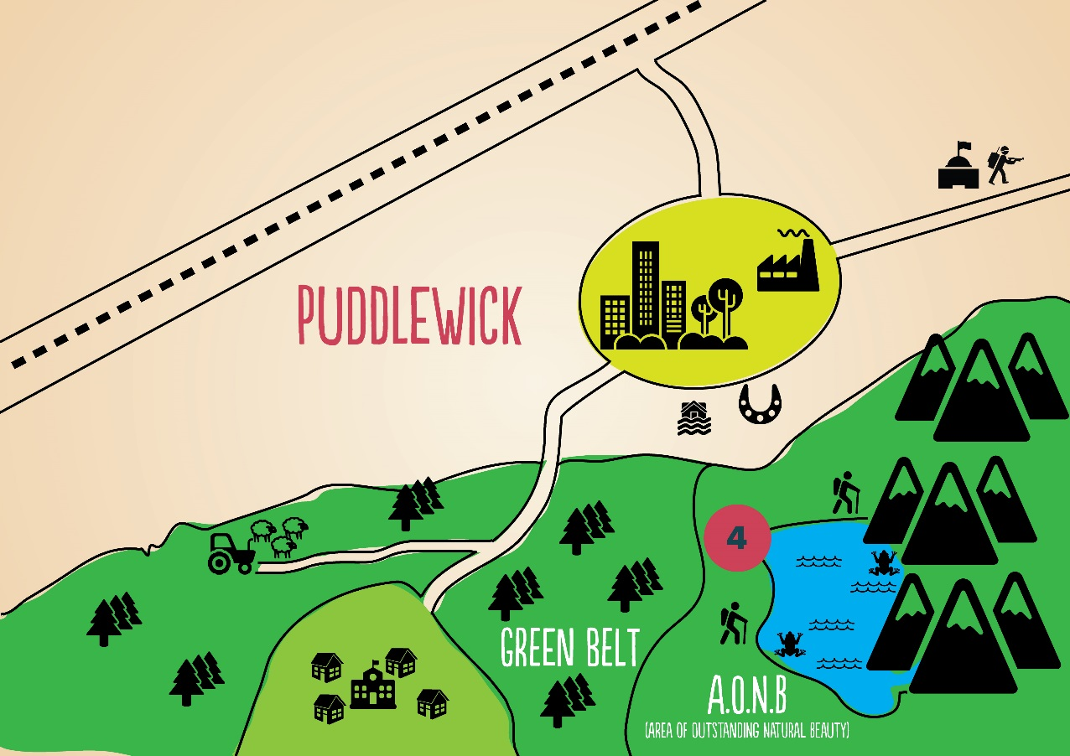
Option 4: Land within an Area of Outstanding Natural Beauty (AONB)
“
The site is within an AONB just outside Puddlewick. It is in close proximity to existing domestic buildings but is within sight of a permitted footpath that ramblers and walkers regularly use. The site is also claimed to be where the rare greater-footed toad nests, a species that has protection status from the government and thus makes the area a Site of Special Scientific Interest (SSSI). Transport links would require improvements to sustain new homes in the area.
”

Slide 10
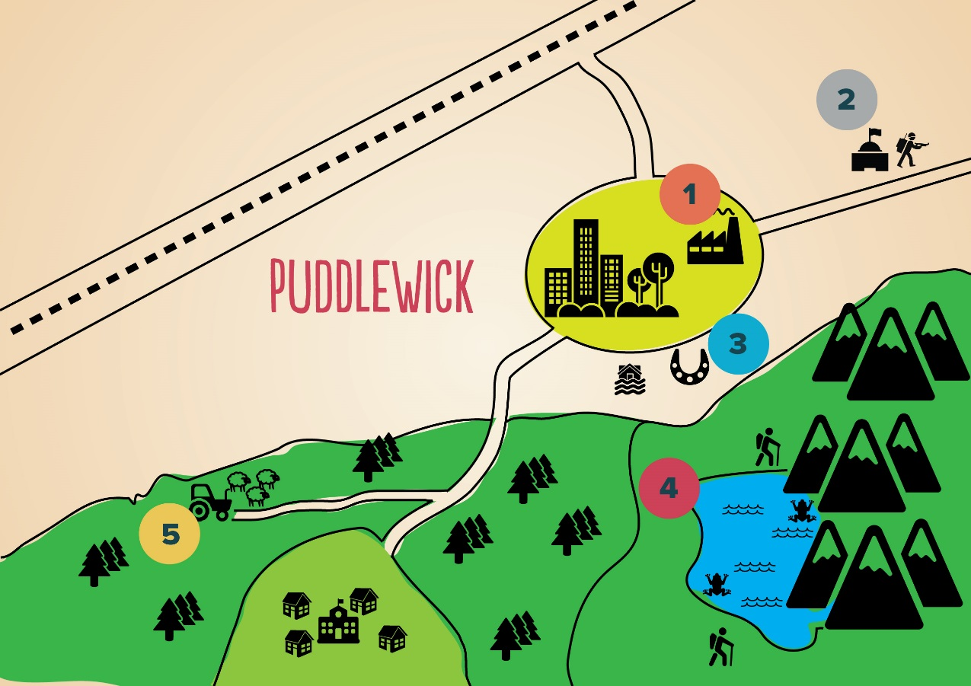
Option 5: Land on the Green Belt
“
The site is within the green belt surrounding Puddlewick. It is owned privately by a local farmer and is currently a disused and rundown cattle shed that the farmer is using to store old tractors and other mechanical equipment. It is not within a designated AONB and is not near regular walking or rambling paths. There are no archaeological or ecological reasons that would prevent building. It was originally designated as Green Belt “to safeguard the countryside from encroachment” and “to encourage the recycling of derelict and other urban land”, i.e. brownfield land. Transport links would require minor improvements, but the site is near a well-used B-road and currently serves local traffic between towns.
”

Slide 11
Decision time…
Write up your decision:
Paragraph 1 Make it clear which site you have chosen, this is your conclusion.
Paragraph 2 Give at least two developed reasons why your site is the best options. Remember to name specific groups of people
Paragraph 3 Give at least one disadvantage of your chosen site.

