Slide 1
How does South Oxfordshire plan to meet the housing need?
Lesson 7
Understanding how South Oxfordshire plans to meet the demand for new homes.

Slide 2
Developing a local plan…
Look at the simplified process for developing a local plan.
Write two lists:
Name the groups of people that should be consulted.
What investigations do you think the council need to make?
Council comes up with ideas and undertakes investigations
The public are asked for their opinions during a Public Consultation
The council alters its plans and responds to the public.
When everyone is happy the council publish a ‘Local Plan’

Slide 3
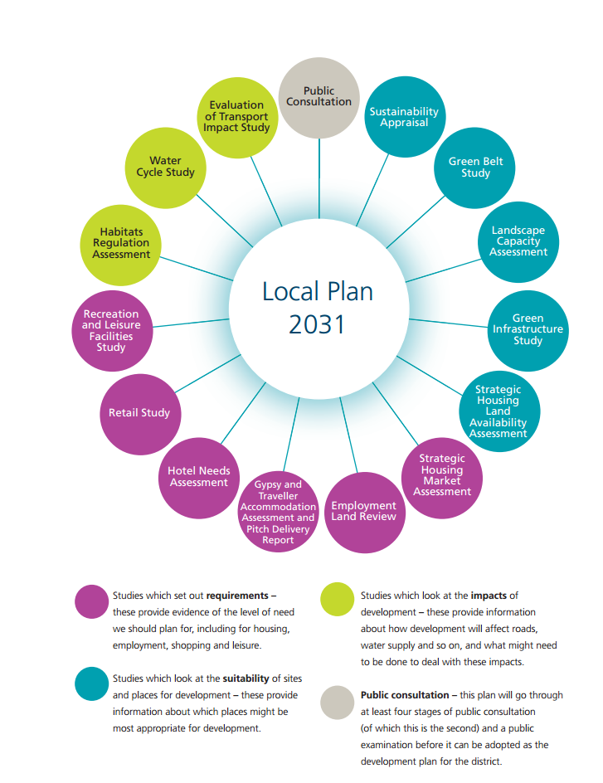
Look at the below…
These are the studies that South Oxfordshire Council have carried out as part of their Local Plan 2031.
For each one:
Identify the groups of people that would be affected.
Add a ‘so that’ statement – why is it important to carry out each study?
Notes:
Source: http://www.southoxon.gov.uk/sites/default/files/2015-02-02_SODC%20LP2031%20REFINED%20OPTIONS%20DOCUMENT%20Final%20web%20ready_1.pdf

Slide 4
Where should the new homes go?
Use the information contained in the Local Plan 2031 summary document to fill in the following table. Remember to name groups of people who would object / support each idea.
Area for new housing | Advantages | Disadvantages
Science Vale
Market Towns and Larger Villages
Smaller Villages
Larger Villages
Travelling communities
Town centres
Notes:
Local Plan 2031 summary document available here: http://www.southoxon.gov.uk/sites/default/files/2015-02-16_SODC LP2031 Leaflet Final Right Way Upcombined web.pdf

Slide 5
Green Belt serves five purposes…
to check the unrestricted sprawl of large built-up areas;
to prevent neighbouring towns merging into one another;
to assist in safeguarding the countryside from encroachment;
to preserve the setting and special character of historic towns; and
to assist in urban regeneration, by encouraging the recycling of derelict and other urban land.
Considering this, are there circumstances in which South Oxfordshire should be able to build on Greenbelt land?
Notes:
See planning guidance on the Green Belt at: http://planningguidance.planningportal.gov.uk/blog/policy/achieving-sustainable-development/delivering-sustainable-development/9-protecting-green-belt-land/

