Slide 1
How do councils make decisions on where to build new homes?
Lesson 6
The advantages and disadvantages of brownfield and greenfield land.

Slide 2
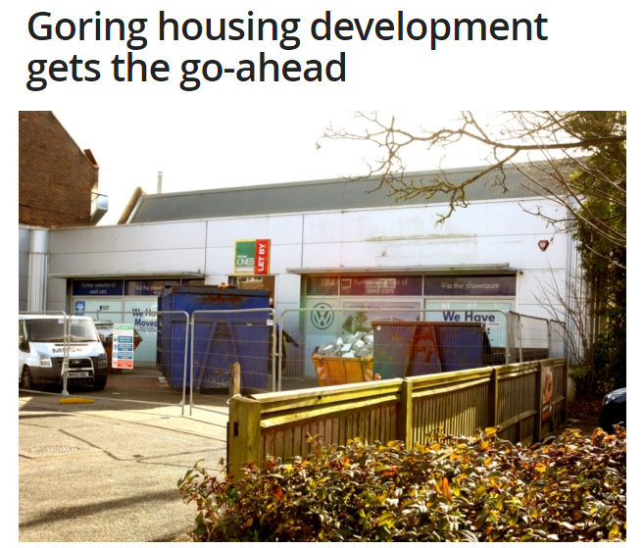
Read the news article below...
“
Councillors have given their backing to a developer’s proposal to build 17 properties on a derelict car garage site.
The development – which just needs to be signed off by council officers – will see nine two-bedroom houses, six three-bedroom houses and two two-bedroom flats built on the former Caffyns VW site in Goring Road, Goring.
Twelve of the properties will be private market housing with the remaining five designated as affordable housing. The site will include 23 car parking spaces.
Safety concerns surrounding access to the site and a potential lack of parking space were issues raised at a planning meeting at Worthing Town Hall last Wednesday night.
Councillor Hazel Thorpe said: “Even though the houses are cramped and not a particularly exciting design it does have some merits.
“I still think there are issues that need to be resolved – certainly parking, and the narrow vehicle access really does concern me.”
The access road is 2.8 metres wide with no room to expand.
Councillor Kevin Jenkins said the development was a good use of the brownfield site but he wanted to make sure emergency service vehicles could access the site.
Councillor Edward Crouch said he was keen for traffic calming measures to be implemented before any development begins.
West Sussex County Council has requested more than £114,000 in section 106 contributions towards education, libraries, fire and rescue and transport infrastructure from the developer.
Bob Niall, from the Ilex Conservation Group, said he was surprised no contributions would be made towards medical facilities given the volume of residents being housed on the site.
A letter of objection from Sussex Audiology, a business adjacent to the site, claimed the proposal would be an overdevelopment of the site with no amenity space for the flats.
”
From the Worthing Herald, 12 March 2015.
What are the advantages and disadvantages of using this site?
Which groups of people will be involved?
Is this a site to build new homes on?
Notes:
Source: http://www.worthingherald.co.uk/news/local/goring-housing-development-gets-the-go-ahead-1-6624813
Need to get permission from the paper.

Slide 3
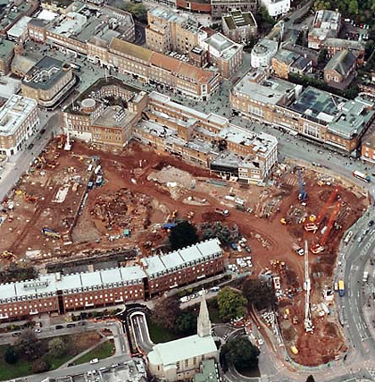
Brownfield or Greenfield – Which is best?
Greenfield – A site that has not been built on before. Often rural/countryside areas. This includes the rural-urban fringe.
Brownfield - A site that has been built on before and is ready for development. Normally associated with urban inner city areas.

Slide 4
Look at the statements below…
1. Brownfield redevelopment eases pressure on Greenfield sites and is more sustainable – Its good to reuse land | 2. Greenfield sites are often on the edge of towns and cities and may have better access, have less congestion, be in a more pleasant environment and have more space to expand
3. House prices would increase in inner city areas as people are encouraged back into the area | 4. Infrastructure already exists in urban areas
5. Building on Greenfield sites ‘sucks’ out the core from towns as shops, etc. locate on the edge of towns/cities | 6. New employment opportunities if Brownfield sites are developed
7. New housing can lead to gentrification (old housing done up – area becomes more trendy and affluent) so the area will improve and statistics like crime rates will improve | 8. New sites are easier to build on as there is a fresh start, where remains of previous land-use do not need to be cleared, and is more attractive to retail parks, housing developers, etc
9. Providing public transport networks is easier in central areas where the population densities are high – investment is focused in central areas | 10. There may be an issue of contamination and making sites safe for development, given what the land may have been used for before
11. Towns and cities do not want their areas to decay – redevelopment results in more people coming to the area, which helps local businesses | 12. Using Greenfield sites is often not sustainable
13. Increased house prices due to inner city redevelopment might mean that local people cannot afford the houses, and the council will have the problem of providing for them | 14. In Greenfield sites new drainage, electricity, roads, etc would all have to be produced
15. Building on Greenfield sites may reduce traffic and congestion in cities | 16. Wildlife may suffer when Greenfield land is built on – may lose habitats, trees may have to be cut down, etc
17. Large family houses with gardens are more likely to be able to be built on Greenfield sites – often not enough space for this in Brownfield areas | 18. Redeveloping Brownfield sites can bring a ‘dead’ area back to life
19. Clearing rubbish from Brownfield areas is expensive | 20. People may protest to Greenfield developments

Slide 5
Brownfield or Greenfield – Which is best?
I think that …………..field is best because…………………………………………………………………………….….………………………………………….….……………………………………………..
What do you think?
Based on what you’ve learned, copy and complete the speech bubble stating your opinion.
Notes:
Mini plenary

Slide 6
Questions…
What do you think the most important advantage is for:
a) Greenfield sites
b) Brownfield sites
Give reasons for your choices.
What do you think the most important disadvantage is for:
a) Greenfield sites
b) Brownfield sites
Give reasons for your choices.

