Slide 1
Case study:
Bath Riverside
Lesson 5
Does the Bath Riverside development encourage sustainable communities?

Slide 2
Is Bath Riverside a sustainable community?
Use this page to keep notes whilst you explore the resources. Use it to plan your case study answer.
Active, inclusive and safe | Well run | Environmentally sensitive | Well designed and built | Well connected | Thriving | Well served | Fair for everyone
Notes:
This is best printed off on A3

Slide 3
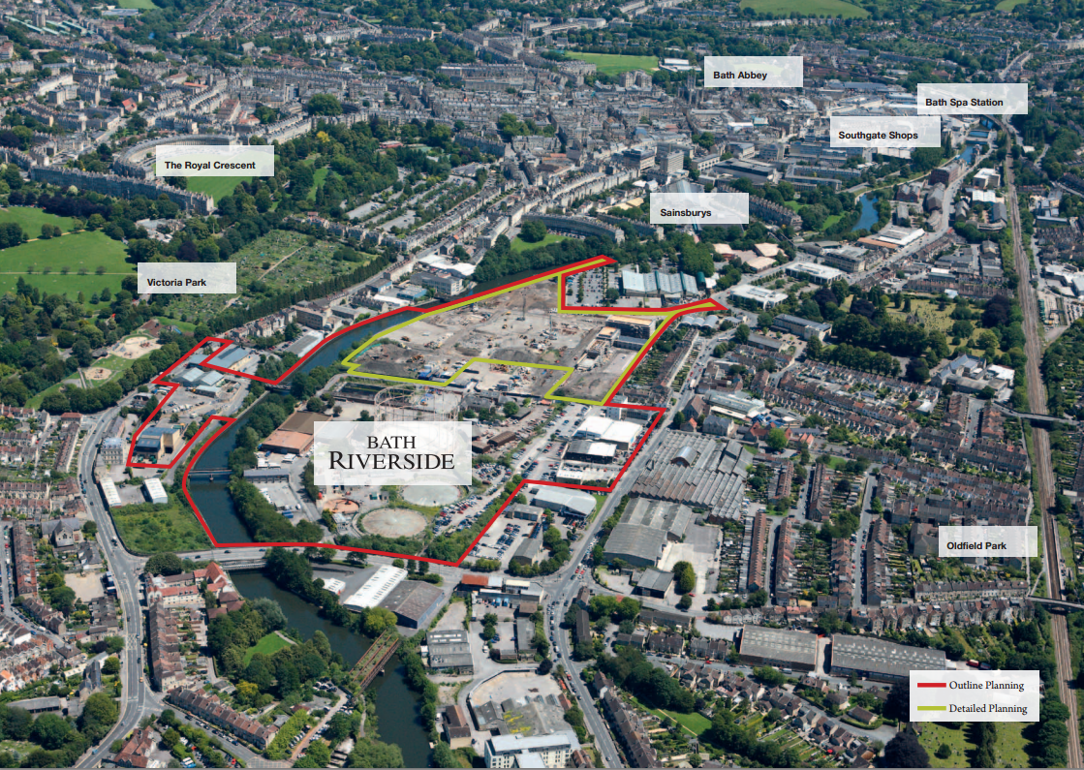
Bath Riverside Aerial view
Expand the labels into annotations by adding ‘so that’ statements.
For example:
Victoria Park, so that residents can easily access recreational space.
Notes:
Taken from https://www.curo-group.co.uk/media/36795/curo_brochure_v9.pdf it would be great if we could use this

Slide 5
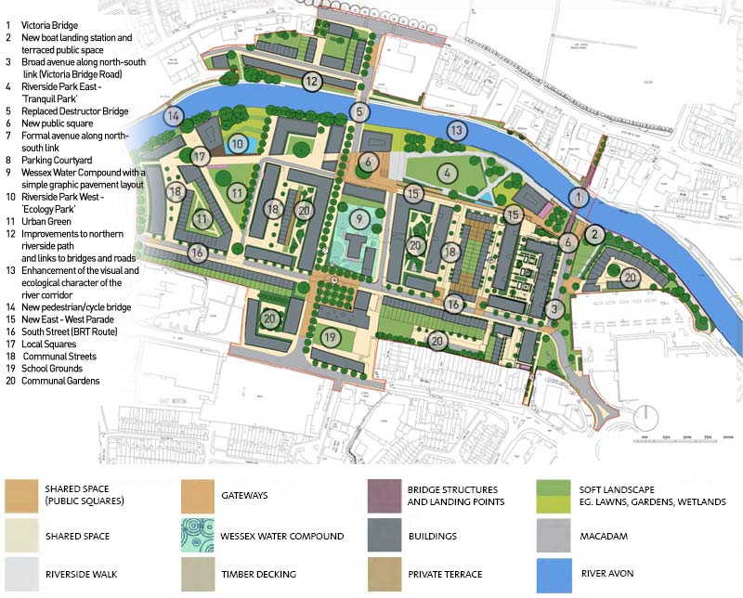
Bath Riverside Planned Development
Add information to your ‘sustainable communities’ worksheet.
Notes:
Taken from here: http://www.bathwesternriverside.co.uk/wp-content/uploads/2011/12/proposed-development.jpg

Slide 7
Consider the following information…
Add relevant snippets to your case study plan.
There was a ‘soil hospital’ on site that moved and cleaned over 45,000 tons of soil on site | More than 18,500 trees and shrubs were planted during Phase 1 of development. | Affordable housing and student accommodation is available as part of Bath riverside. | 20 different species of plant have been put into the roofs of the development, with the seeds being collected from on site before development begun.
Bath Riverside is a brownfield site. | The Bath Riverside Art Strategy provided points of interest all around the site. | The project included improving infrastructure such as replacing Bath’s Destructor Bridge with a better bridge. | Photovoltaic cells were not used in this World Heritage City as it would have spoilt the view of Bath from the surrounding countryside.
More than 400 tons of local Bath Stone was used during phase 1 that matched existing building in the city. | Part of the development included an innovative power station. | Bath Riverside is a mixed land use development. | Plans included flood prevention schemes.
A public park was included in the development. | There is a riverside walk that is open to the general public. | The first phase of 299 homes included 121 affordable homes and is a mixture of 1,2, and 3 bedroom apartments and 3-4 bedroom townhouses. | Rest Nicolson, the developer, supports local charities.
The developer worked with the Environment Agency to provide landscaped areas that are able to flood when river levels are high. | The developer worked with insurance companies to ensure that they would insure the homes at Bath Riverside from flooding. | Residents are invited to pick apples and forage for strawberries in the gardens. | A competition was run for local school children to design points of interest and art. Some of the old industrial buildings have been preserved.

Slide 8
Considering what you know…
Answer the following question:
“
”
Is Bath Riverside a sustainable community?
1
2
3
Answer using three developed points.

