Slide 1
How do house builders meet local needs?
Lesson 3
What factors are explored to help decide how many and what sort of homes are needed?

Slide 2
Look at the following data...
Write:
If you were a house builder, what type of homes would you build here?
Why?
Refer to data in your answer.

Slide 3


But, it’s not a simple formula…
Andrew Whitaker, Planning Director at the Home Builders Federation, explains:
“
House builders will, using analysis of existing household types, work out what their customer base could look like in a particular area and what sort of homes they will therefore want to buy. Furthermore, developers would also look at the existing stock (homes) within an area and would see if there were any obvious gaps in terms of “need” and “supply”.
“For example, if there are lots of small terraced houses in an area then a developer might say – the area attracts people who want smaller dwellings so I’ll build some of those or they might say there’s a shortage of larger dwellings so I’ll build some of those.
”

Slide 4
Look at the Venn diagram below…
Record factors that influence the decision of where to build new houses.
Social
Economic
Environmental
Help!
Social = people and communities
Economic = Jobs and money
Environmental = the built and natural environment
You may find it useful to search your local newspaper’s website for housing stories.
e.g. are there enough schools in the area?
e.g. are the existing houses run down and in poor condition?
e.g. what’s the average house price in the area?

Slide 5
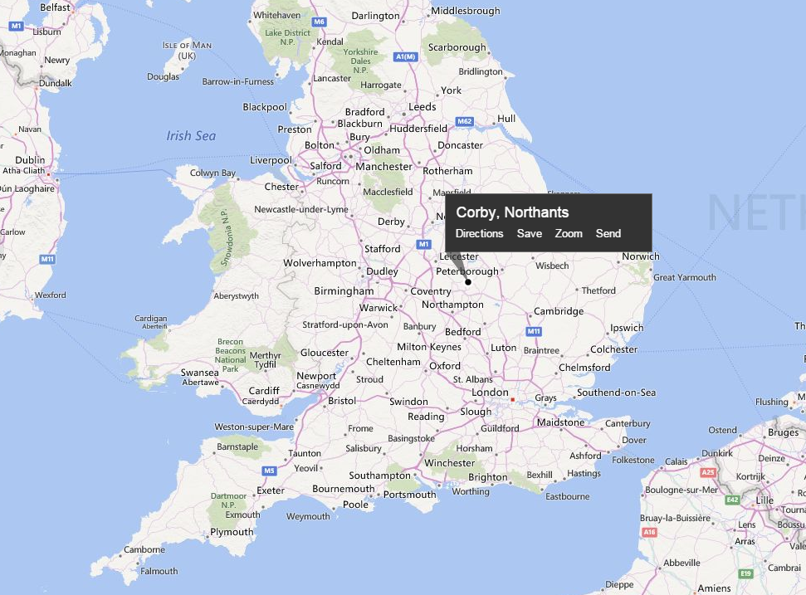
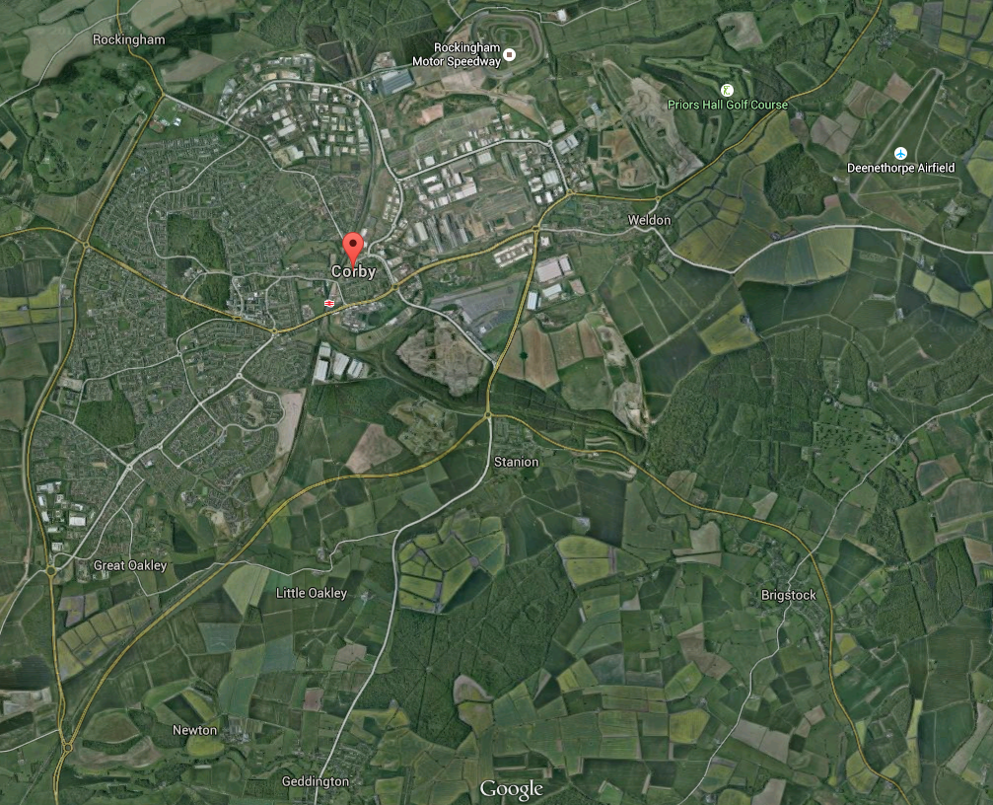
Describe the location of Corby
Image courtesy of Google Earth.
Image courtesy of Bing Maps.

Slide 6
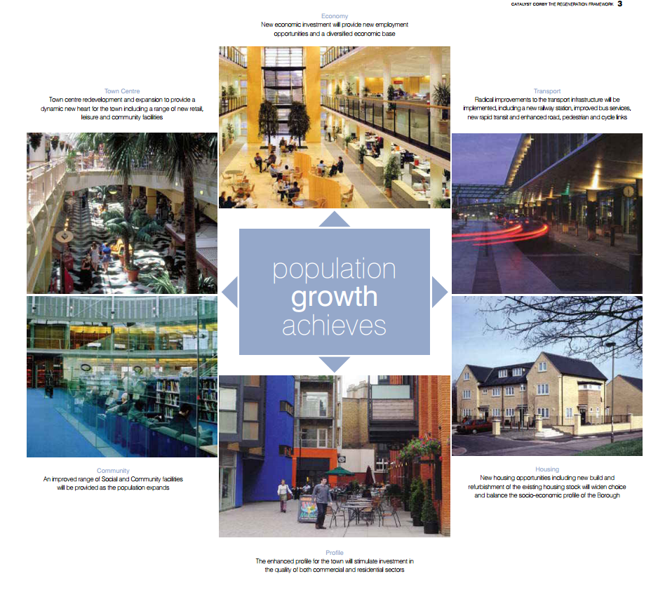
The challenge for Corby…
Corby has one of the fastest growing populations in the UK. Rather than see this as a problem, the local council see it as an opportunity.
Look at the following opportunities identified:

Slide 7
The challenge for Corby…

Slide 8
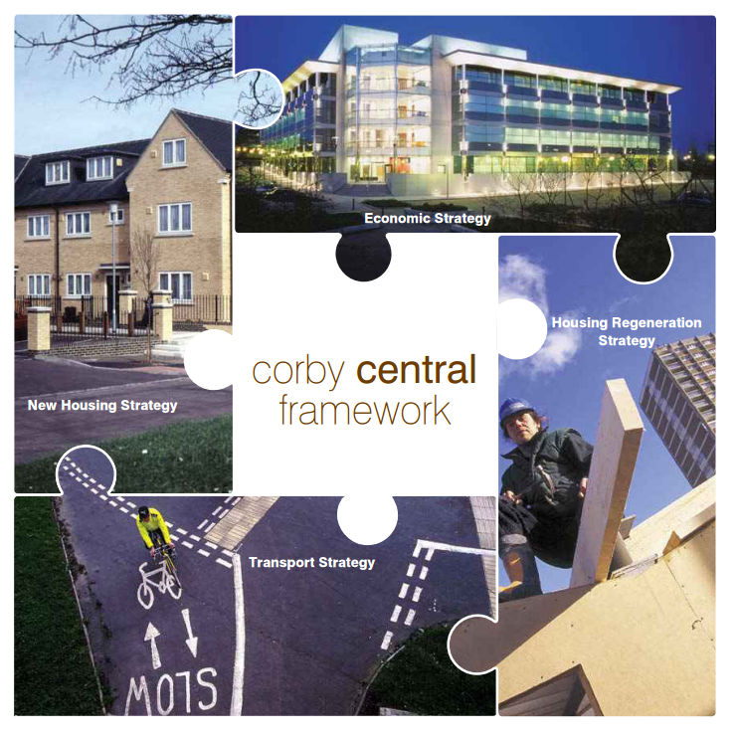
Regenerating Corby…
It is important when regenerating Corby that all of the elements work together:
“There aren’t too many people in the UK; the country is not full. However, poor investment in services is the problem.”
BBC Question Time comment

Slide 9
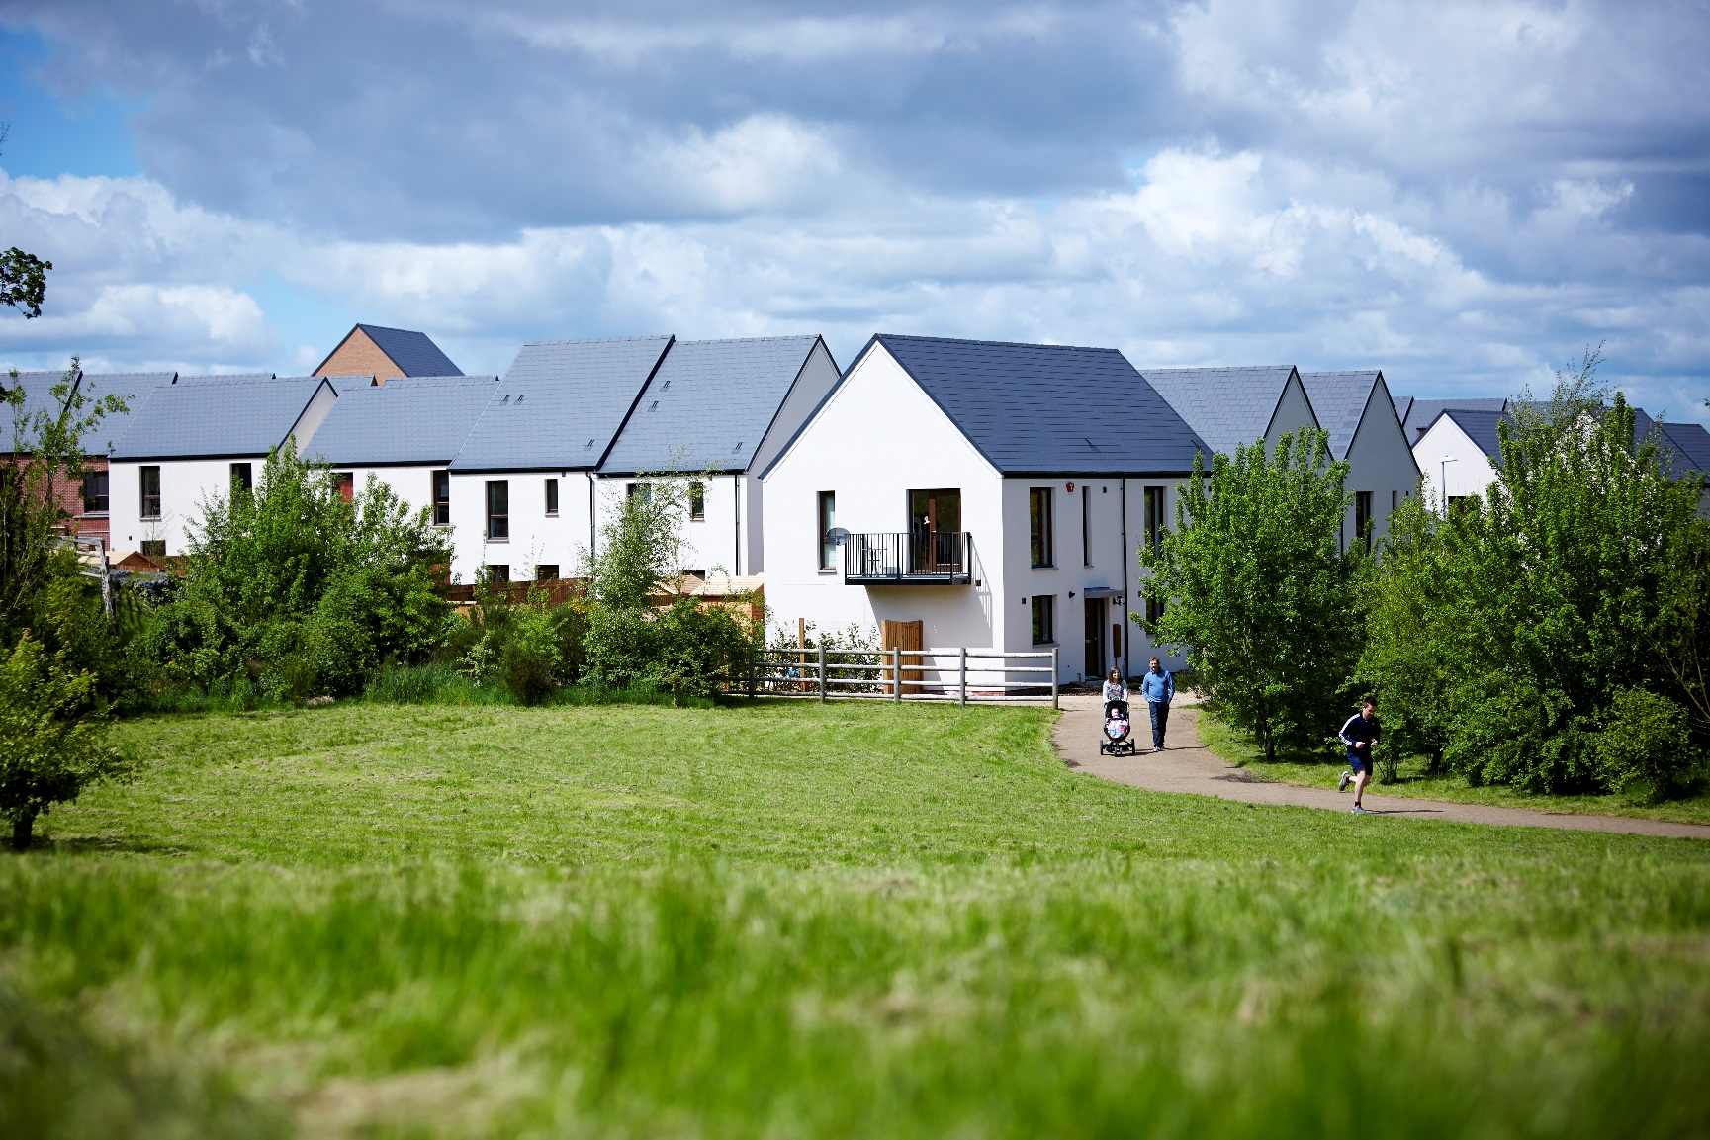
The residential strategy for Corby…
Corby’s population is expected to grow by over 47,000 people with around 2.3 people living per household.
Thinking about what you know already, how many new homes do you think Corby needs?

Slide 10
Five aspects of Corby’s residential plan are below…
For each one, create a ‘so that’ statement that explains the impact of this on the town.
EXAMPLE: New opportunities will be identified to make the town centre a more attractive place to live… | …so that… | ..the community isn’t undermined by migration from the older housing to more attractive areas.
Run down areas of housing, caused by poor urban design and lack of investment, will be improved …. | …..so that….
Several brownfield sites have been identified… | ….so that…..
New homes will be evenly spread throughout Corby.. | ….so that…..
Greenfield sites have received planning permission and will be used to create low density housing… | …so that….

