Slide 1
How have populations changed across the UK?
Lesson 2
Exploring patterns of internal migration and population change in the United Kingdom.

Slide 2
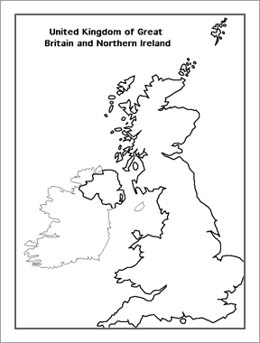
How have populations changed across the UK?
Do now:
Using the shapes below, create a sketch map of the UK. You may have to rotate them and resize.
Extension: Mark on the location of: London, Cardiff, Edinburgh, Belfast

Slide 3
How did you do?

Slide 4
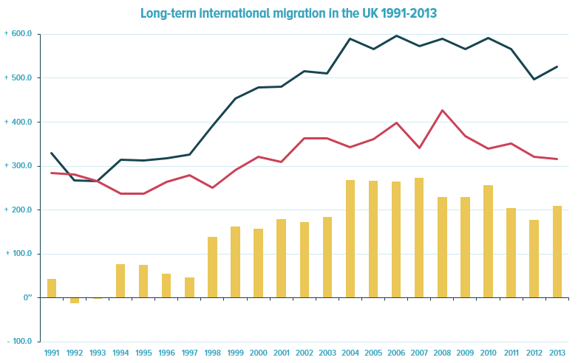
Look at this graph…
Write a description of the long term changes in international net migration.
Notes:
Source: http://www.ons.gov.uk/ons/rel/migration1/long-term-international-migration/2013/index.html

Slide 5
What is internal migration?
Internal migration is the movement of people within a country or region, in this case within the UK.
What push and pull factors would cause people to migrate within the UK?
Example | Internal or International?
Syria to London
Cardiff to Southampton
Australia to Glasgow
South Africa to Newcastle
Republic of Ireland to Exeter
Belfast to Cardiff
Brighton to Worthing
Beijing to Glossop
Carmarthen to Portsmouth
New York to Blackpool

Slide 6
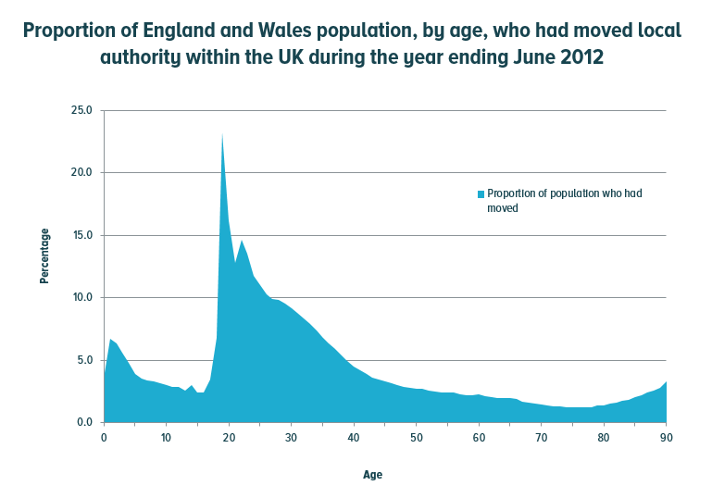
Look at this graph…
What are the push and pull factors that would cause people to decide to move within the UK?
Think about:
Who might be moving?
Why are they moving?
Where are they moving to?
Notes:
Source: http://www.ons.gov.uk/ons/dcp171778_315652.pdf

Slide 7
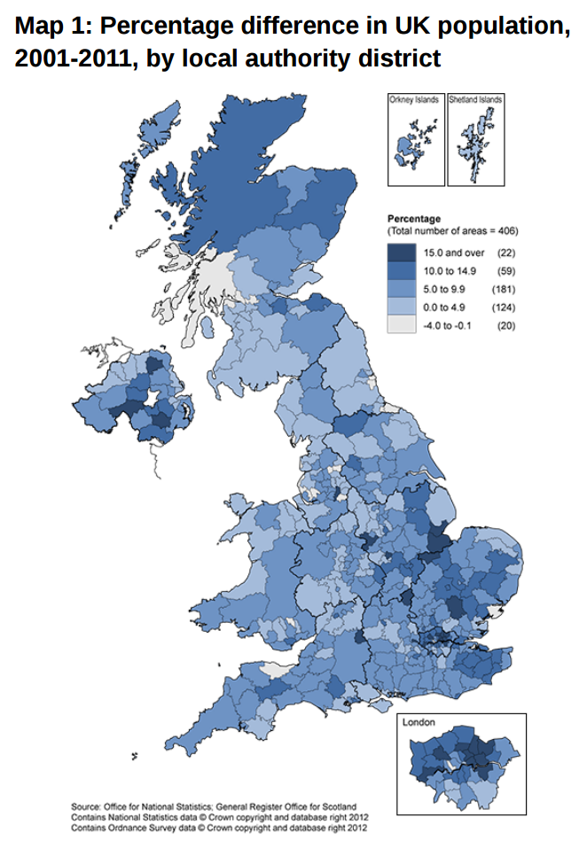
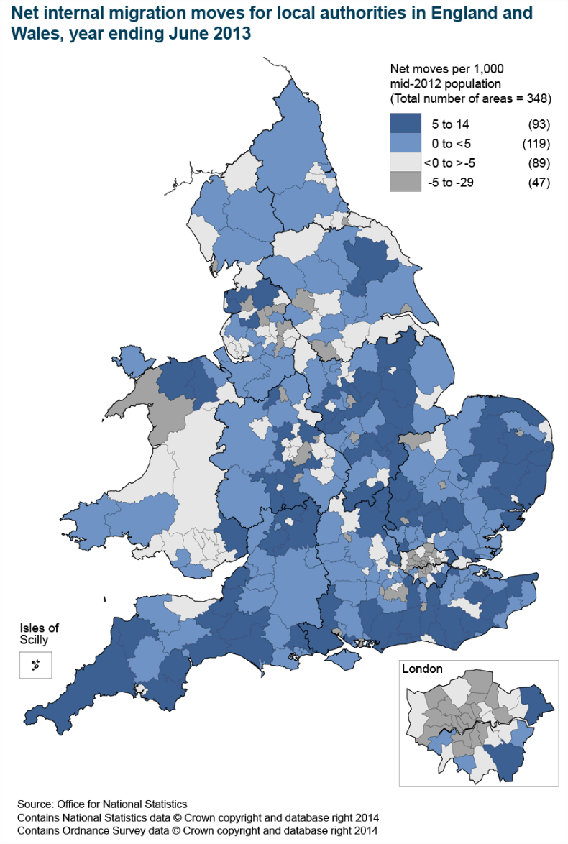
Look at these maps…
The maps show how local populations have changed in the UK.
From looking at these maps, what does it tell us about housing demand across the UK?
Notes:
Map 1: http://www.ons.gov.uk/ons/dcp171778_292378.pdf
Map 2: http://www.ons.gov.uk/ons/dcp171778_368416.pdf

Slide 8
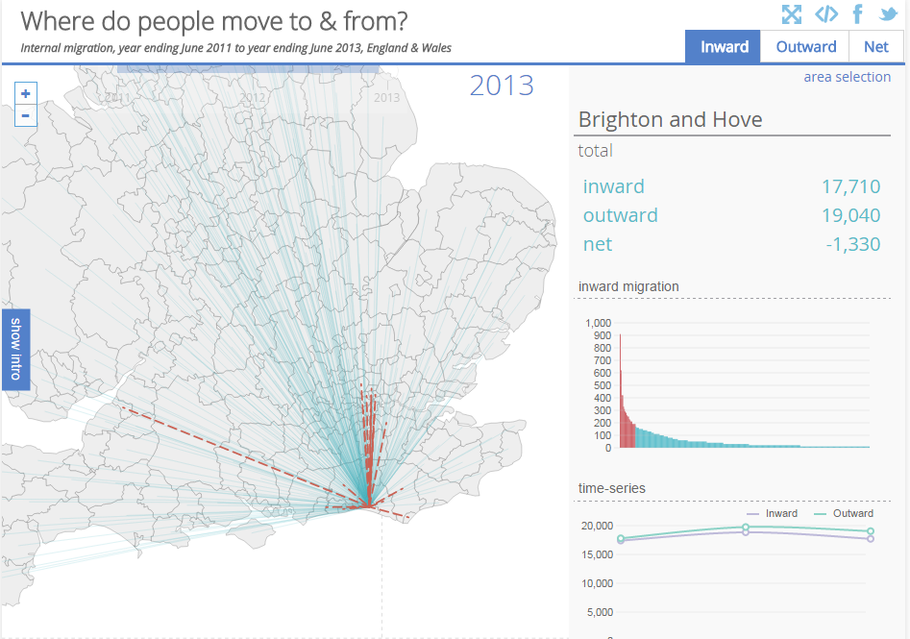
Explore a map of your area…
Does your local area have a positive or negative net migration figure?
Where has to largest negative net migration figure?
Where has the largest positive net migration figure?
Notes:
Source: http://www.neighbourhood.statistics.gov.uk/HTMLDocs/dvc25/#sty=true&flow=flow0&period=2&fix=E06000043&view=362.5,118.75,325,317.5&tr=-39.6610107421875,-118.43222045898438&sc=1

Slide 9
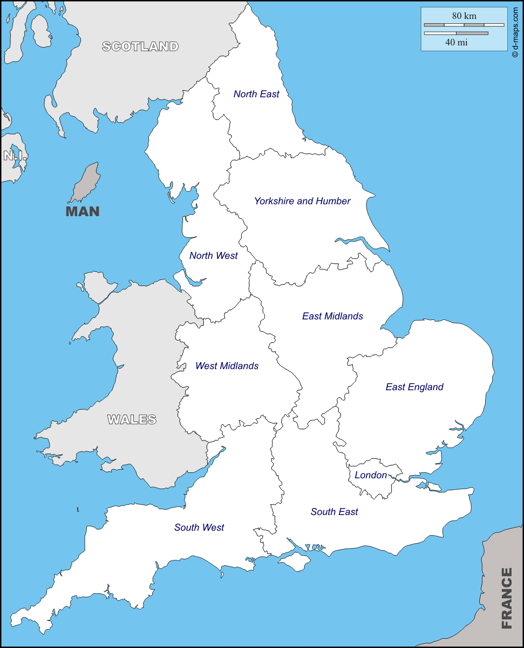
Where is housing needed the most?
Key
Using the Average annual increase column, create a key.
Create a choropleth map by shading each region. You should use the same shade, and use a darker shade to show where most new houses are needed.
In your exercise book, describe where the highest demand for new houses is. Compare this to the region which you live in.
Describe the trend for England as a whole. Does the country need more or fewer homes?
Region | Average annual increase in houses needed between 2008 and 2033 (thousands) | Total increase of houses needed 2008-2033
North East | 8 | 19%
North West | 22 | 18%
Yorkshire & The Humber | 27 | 31%
East Midlands | 22 | 29%
West Midlands | 18 | 20%
East | 32 | 34%
London | 36 | 28%
South East | 39 | 28%
South West | 27 | 30%
England | 232 | 27%

Slide 10
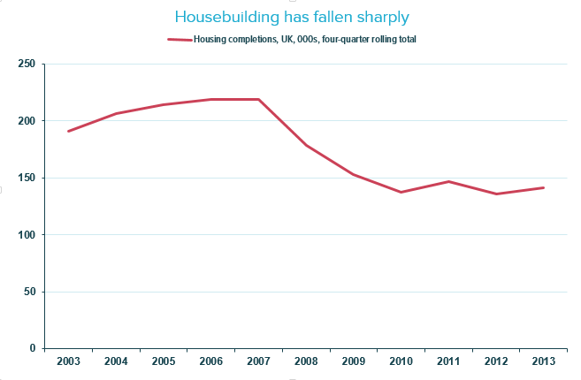
But, there’s a problem…
A table showing the number of completions in England and Wales over the last 10 years.
Financial Year | United Kingdom
2003 | 190,590
2004 | 206,620
2005 | 214,000
2006 | 219,070
2007 | 218,530
2008 | 178,790
2009 | 152,940
2010 | 137,450
2011 | 146,850
2012 | 135,510
2013 | 140,930

