Slide 1
Why does the UK need new houses?
Lesson 1
What factors affect population changes? How does that impact on the need for new homes?

Slide 2
Why does the UK need new houses?
How has the UK’s population changed in the last 50 years?
Population
Time

Slide 3
Why does the UK need new houses?
Draw a line graph predicting what has happened to the UK’s population over time.
Describe your prediction in words: ‘I predict that the UK’s population has…..’
Population (y)
Trends v Variation video
Time (x)

Slide 4
Data detectives!
Describe the Trend
Describe the variation
Notes:
Source: http://www.ons.gov.uk/ons/rel/pop-estimate/population-estimates-for-uk--england-and-wales--scotland-and-northern-ireland/2013/sty-population-changes.html

Slide 5
Why is the UK’s population growing?
Why is the UK’s population growing?
Why is the UK’s population growing?
What are the factors that are leading to the UK’s population changing?
Highlight those which you think are most important.

Slide 6
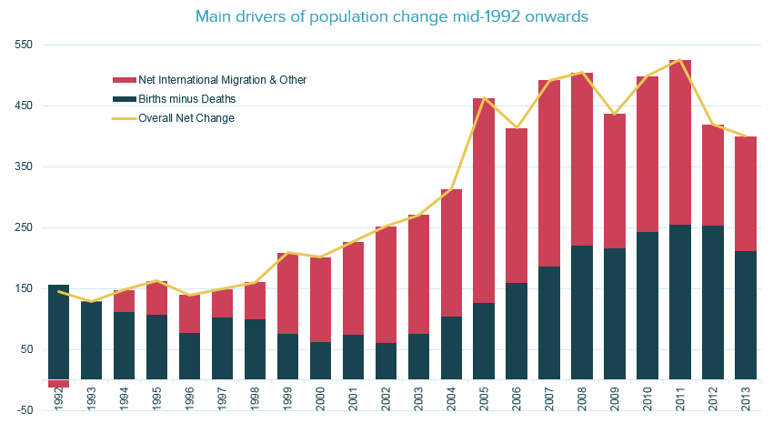
Look at this graph…
Describe changes in the UK’s annual population change since 1992.
What may happen in the future?
Notes:
Source: http://www.ons.gov.uk/ons/rel/pop-estimate/population-estimates-for-uk--england-and-wales--scotland-and-northern-ireland/2013/sty-population-changes.html

Slide 7
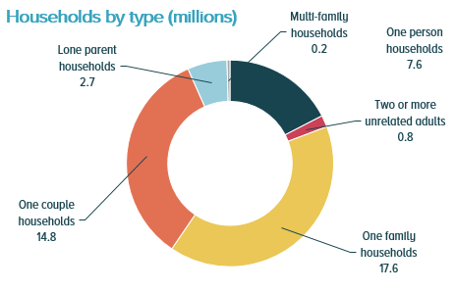
The drivers of household demand…
3.6m
8%
▲
2.4m
28%
▲
1.7m
19%
▼
The increase in people living alone aged 45 to 64 is possibly due to …
…a rise in divorced people and a fall in married people.
Fewer 16 to 44-year-olds are living alone, which may be because…
…it has become less affordable.
The growth in people aged 65 and over living alone is partly due to…
…the ageing population.
Notes:
Source: http://www.ons.gov.uk/ons/rel/family-demography/families-and-households/2013/info-uk-households.html

Slide 8
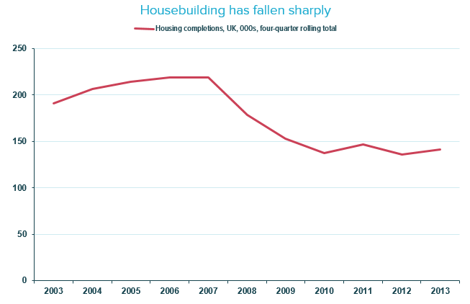
Look at this graph…
Using the knowledge from this lesson so far, what problems does this graph represent?
Notes:
Source: http://www.parliament.uk/documents/commons/lib/research/key_issues/Key-Issues-Housing-supply-and-demand.pdf

Slide 9
Why are more houses needed?
Consider the main changes in the UK’s population.
Explain why new homes are needed.
UK population is increasing… | …this means that…
The UK’s life expectancy is increasing... | …this means that…
The number of houses being built is decreasing… | …this means that…
The number one-person households is increasing… | …this means that…
The majority of homes in the UK are under occupied… | …this means that…
House prices are high… | …this means that…

