Slide 1
How can we make building more energy efficient?
Lesson 10

Slide 2
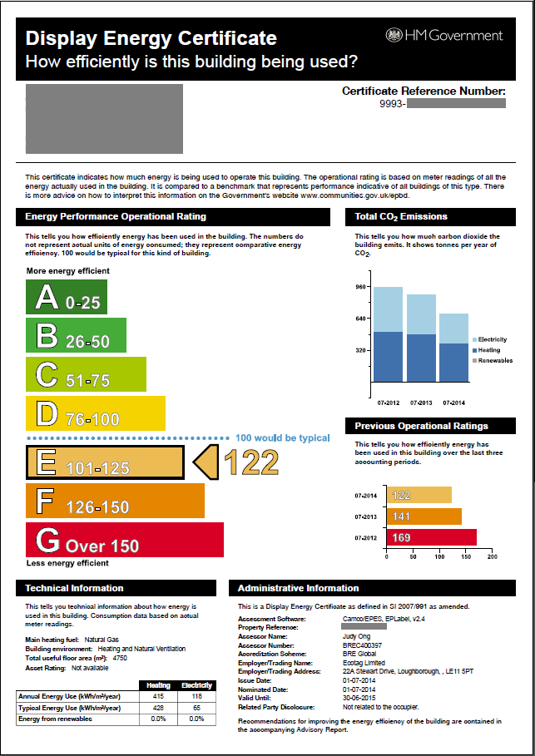
Look at the energy certificate...
In your exercise books answer the following questions:
Why is saving energy important?
List five ways in which home owners can save energy.
Your school should have one of these displayed somewhere!

Slide 3
Options to make a house energy efficient
Look at the fact sheet in front of you.
Thinking about the ways you’ve already listed and those on the fact sheet, design a presentation for your class and teacher.
You should try to:
Highlight ways in which your teacher and classmates can make their homes more energy efficient.
Highlight the benefits of doing so – think about both the financial and global environmental benefits.
Create a visual presentation to compliment it.

